Slide 1


Lesson 1
Introduction

Slide 2
Learning Objectives
By the end of this lesson, you will…
Understand the concepts of block-based coding
Understand basic coding concepts and language
Understand how a sequence/algorithm works

Slide 3
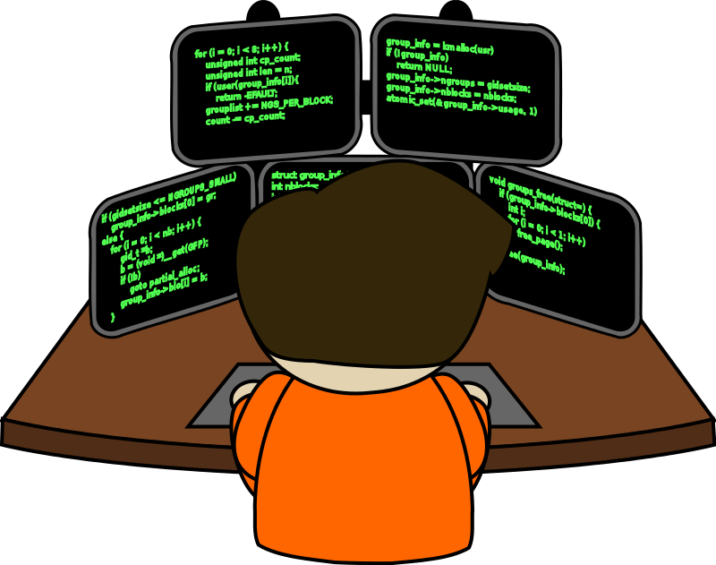
Lesson 1
What is “coding”?
What do you think “coding” means?
Write down what coding means to you and where it appears in your life.

Slide 4
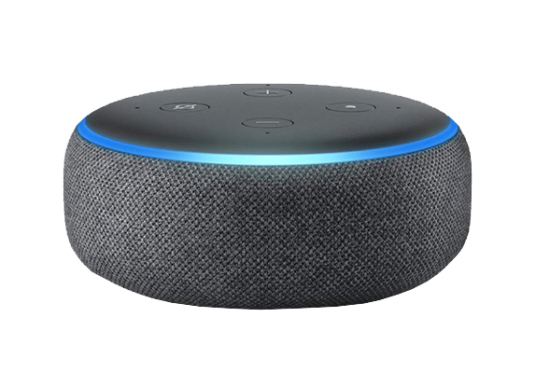
Lesson 1
Coding == Problem Solving
Writing code is a tool to solve problems!
For example, Amazon Alexa is written using code and it provides a way to entertain, shop and talk to others.
Alexa is a large project! Too big for one person to work on. The project is broken down into smaller projects, and teams work on code to solve smaller problems.

Slide 5
Lesson 1
Coding Concepts
Every coding language uses the same key coding concepts!
Sequence
The instructions for our code
Selection
Using logical tests to change the flow of the sequence
Iteration
Using loops to repeat sequences of code

Slide 6
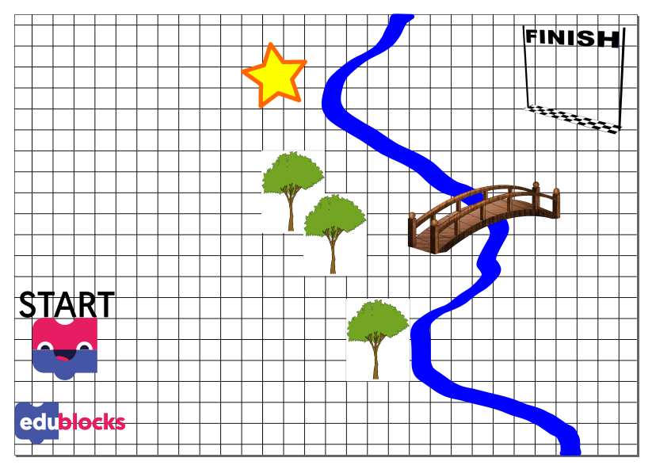

Lesson 1
Writing our own language
Can you help Ed get to the finish line?
In teams, create a written language to guide Ed from start to finish.
He cannot touch trees and cannot walk through water.
Your language should be easy to understand as Ed is easily confused.
Collect the star for bonus points!

Slide 7
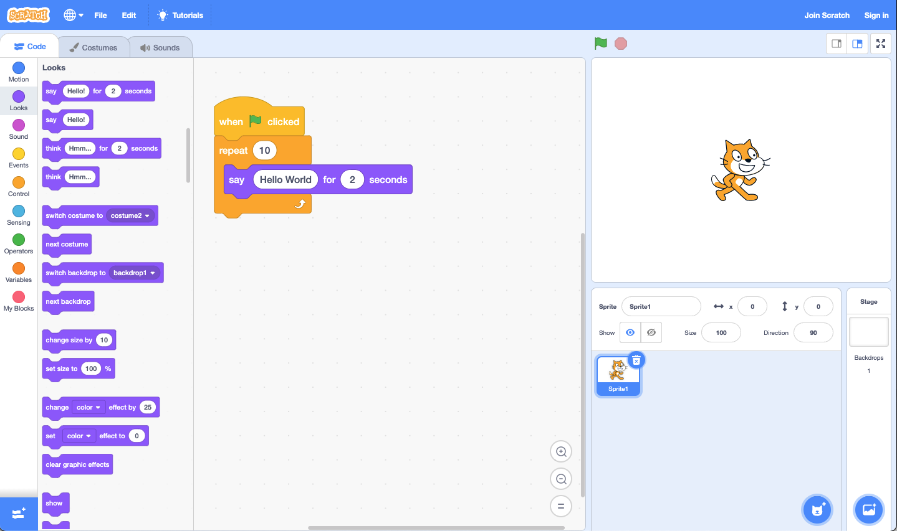
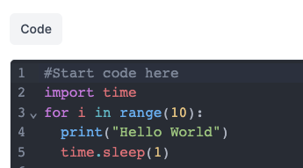
Lesson 1
Moving from Scratch to Python

Slide 8
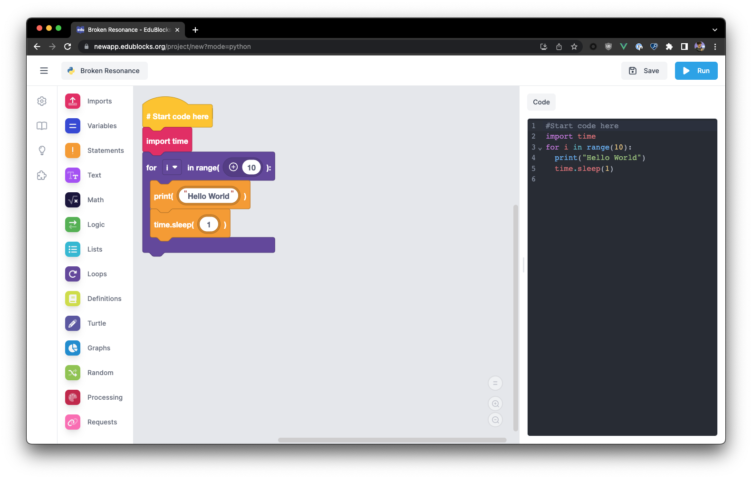
Lesson 1
What is EduBlocks?
EduBlocks is a free application available online at edublocks.org
It was started by a 12 year-old student who wanted to help others learn how to code.
It runs in the browser like Scratch and works on all operating systems
We can write code in pure Python or HTML, or code for use with the micro:bit, Raspberry Pi and Adafruit CircuitPython controller boards.

Slide 9
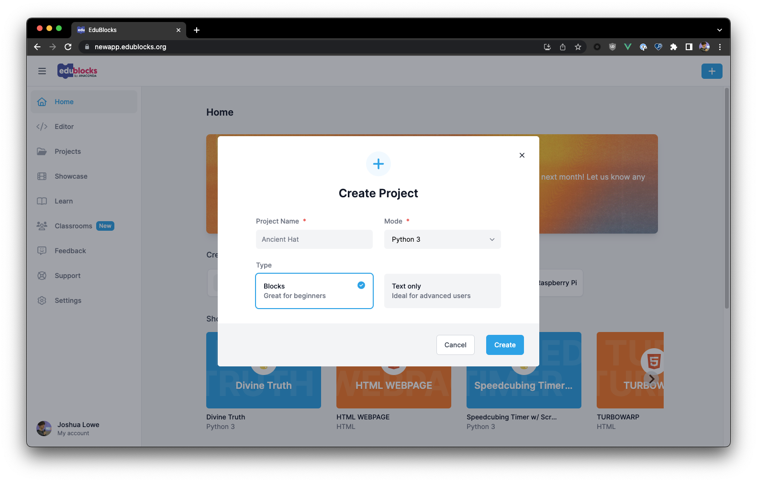
Lesson 1
Using modes
To write code, we’ll need to create a project.
Today we’ll be using Python 3, so we can leave all the default options and click “Create”
To access the different modes, we can go to:
app.edublocks.org/editor

Slide 10
Lesson 1
The Interface
The EduBlocks Interface is simple
On the left we have all of the blocks we can use to write code.
The blocks are places in the coding area on the left of the screen.
On the right we can see the generated Python code.

Slide 11
Lesson 1
Building a sequence of code
We write Python code using the blocks on the left.
The blocks click together like Scratch.
Blocks can be taken apart and put back together.
Blocks are organised in the menu by their function.

Slide 12
Lesson 1
Run the code
To run our code we click the Blue run button. This shows the output on the right of the screen.

Slide 13
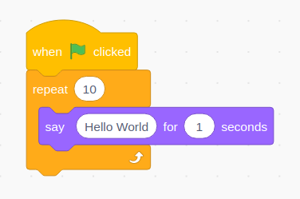
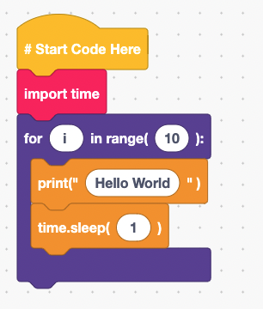
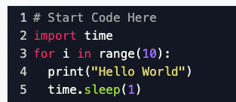
Lesson 1
Same concept, different language
Scratch
EduBlocks
Python
Each of these code snippets will print Hello World on the screen 10 times.
The same coding concept, a loop which iterates 10 times, is used in each snippet.

Slide 14
Plenary
What have we learnt?
Coding concepts are shared across many different languages.
Block languages are ideal for introducing coding.
Computers require clear instructions to work correctly.

Slide 15
Plenary
Next Lesson
Next lesson, we will use EduBlocks to create graphics with Turtle

